Slide 1

Optimal Number of Clusters

Slide 2
Determining the Optimal Number of Clusters
Determining the optimal number of clusters in a data set is a fundamental issue in partitioning clustering, such as k-means clustering, which requires the user to specify the number of clusters k to be generated.
There is no definitive answer to finding the optimal number of clusters. This is somehow subjective and depends on the method used for measuring similarities and the parameters used for partitioning.

Slide 3
Determining the Optimal Number of Clusters
Methods for determining the optimal number of clusters include direct methods or statistical testing methods:
1. Direct methods: consists of optimizing a criterion, such as the within cluster sums of squares or the average silhouette. The corresponding methods are named elbow and silhouette methods, respectively.
2. Statistical testing methods: consists of comparing evidence against null hypothesis. An example is the gap statistic.

Slide 4
Determining the Optimal Number of Clusters
In addition to elbow, silhouette and gap statistic methods, there are more than thirty other indices and methods that have been published for identifying the optimal number of clusters.

Slide 5
Elbow Method
Recall that, the basic idea behind partitioning methods, such as k-means clustering is to define clusters such that the total intra-cluster variation [or total within-cluster sum of square (WSS)] is minimized. The total WSS measures the compactness of the clustering and we want it to be as small as possible.
Computed as shown below:

Slide 6
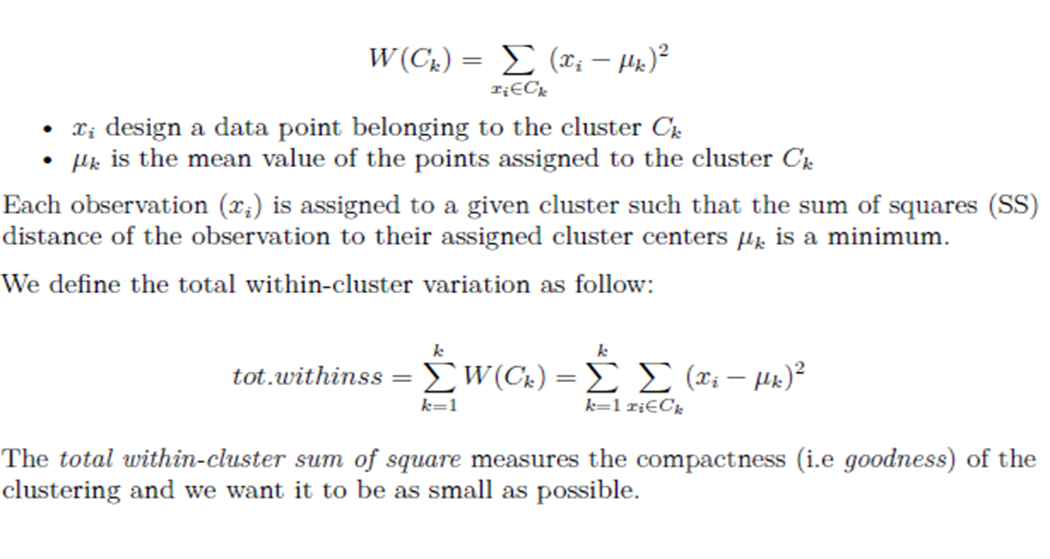
Elbow Method

Slide 7
Elbow Method
The Elbow method looks at the total WSS as a function of the number of clusters: One should choose a number of clusters so that adding another cluster doesn’t improve much better the total WSS.
Note that, the elbow method is sometimes ambiguous. An alternative is the average silhouette method (Kaufman and Rousseeuw [1990]) which can be also used with any clustering approach.
The optimal number of clusters can be defined as follows:

Slide 8
Elbow Method
1. Compute clustering algorithm (e.g., k-means clustering) for different values of k. For instance, by varying k from 1 to 10 clusters.
2. For each k, calculate the total within-cluster sum of square (wss).
3. Plot the curve of wss according to the number of clusters k.
4. The location of a bend (knee) in the plot is generally considered as an indicator of the appropriate number of clusters.

Slide 9
Average silhouette method
It measures the quality of a clustering. That is, it determines how well each object lies within its cluster. A high average silhouette width indicates a good clustering.
Average silhouette method computes the average silhouette of observations for different values of k. The optimal number of clusters k is the one that maximize the average silhouette over a range of possible values for k (Kaufman and Rousseeuw [1990]).

Slide 10
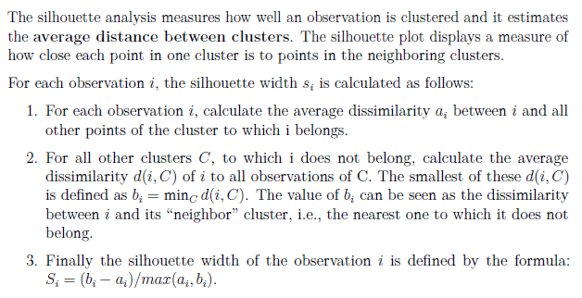
Silhouette Coefficient

Slide 11
Average silhouette method
The algorithm is similar to the elbow method and can be computed as follow:
1. Compute clustering algorithm (e.g., k-means clustering) for different values of k. For instance, by varying k from 1 to 10 clusters.
2. For each k, calculate the average silhouette of observations (avg.sil).
3. Plot the curve of avg.sil according to the number of clusters k.
4. The location of the maximum is considered as the appropriate number
of clusters.

Slide 12
Gap Statistic
The gap statistic compares the total within intra-cluster variation for different values of k with their expected values under null reference distribution of the data.
The estimate of the optimal clusters will be value that maximize the gap statistic (i.e., that yields the largest gap statistic). This means that the clustering structure is far away from the random uniform distribution of points.
The algorithm works as follow:

Slide 13
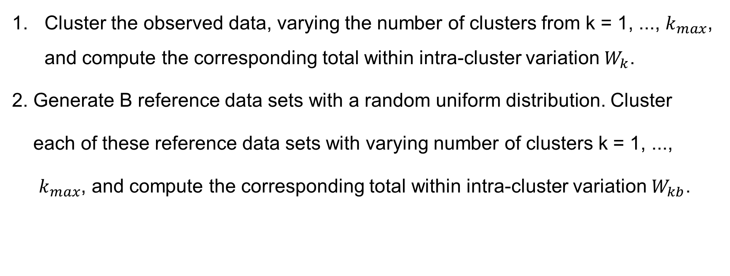
Gap Statistic
Cluster the observed data, varying the number of clusters from k = 1, ..., $k_{max}$, and compute the corresponding total within intra-cluster variation $W_{k}$.
2. Generate B reference data sets with a random uniform distribution. Cluster
each of these reference data sets with varying number of clusters k = 1, ...,
$k_{max}$, and compute the corresponding total within intra-cluster variation $W_{kb}$.

Slide 14
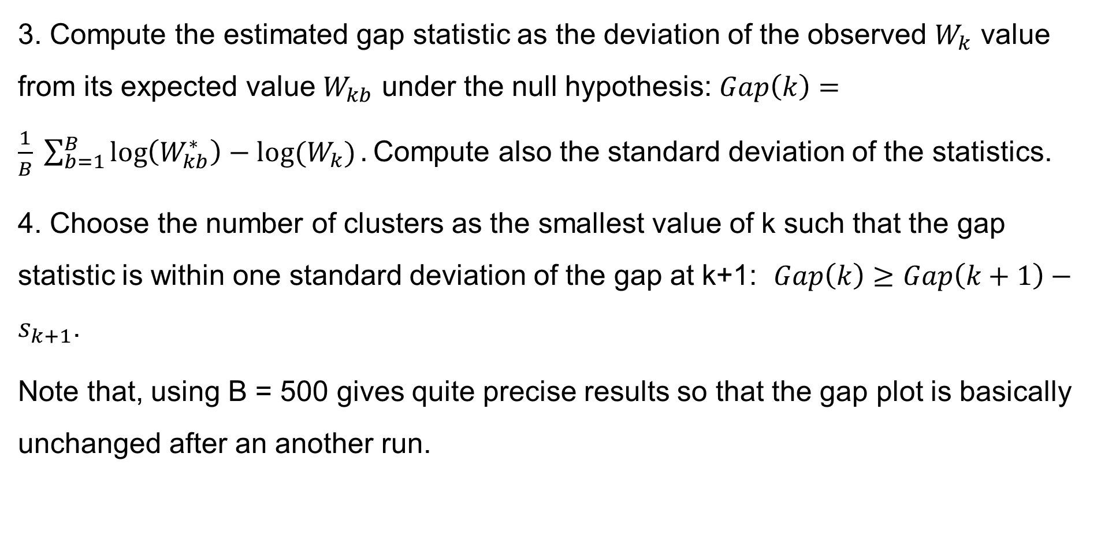
Gap Statistic
3. Compute the estimated gap statistic as the deviation of the observed $W_{k}$ value from its expected value $W_{kb}$ under the null hypothesis: $Gap\left(k\right)=\frac{1}{B} \sum_{b=1}^{B}{\log\left(W_{kb}^{∗}\right)−log⁡(W_{k})}.$Compute also the standard deviation of the statistics.
4. Choose the number of clusters as the smallest value of k such that the gap statistic is within one standard deviation of the gap at k+1: $Gap\left(k\right)≥Gap\left(k+1\right)−s_{k+1}$.
Note that, using B = 500 gives quite precise results so that the gap plot is basically unchanged after an another run.

Slide 15
Computing the number of clusters using R
The fviz_nbclust() function [in factoextra R package]: It can be used to compute the three different methods [elbow, silhouette and gap statistic] for any partitioning clustering methods [K-means, K-medoids (PAM), CLARA].

Slide 16
Note
The disadvantage of elbow and average silhouette methods is that, they measure a global clustering characteristic only. A more sophisticated method is to use the gap statistic which provides a statistical procedure to formalize the elbow/silhouette heuristic in order to estimate the optimal number of clusters.

